Slide 2
Reference
https://www.dj4e.com/assn/dj4e_ads1.md?PHPSESSID=c43dc54a86b1d1afa6b8563caa414a44

Slide 3
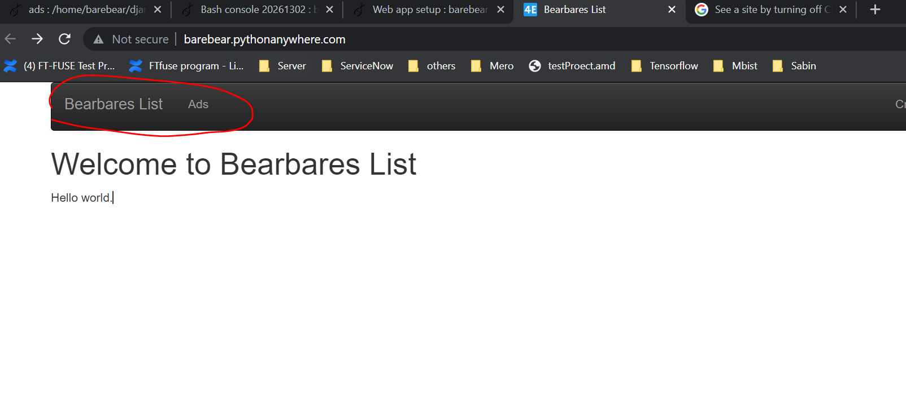
Final output

Slide 4
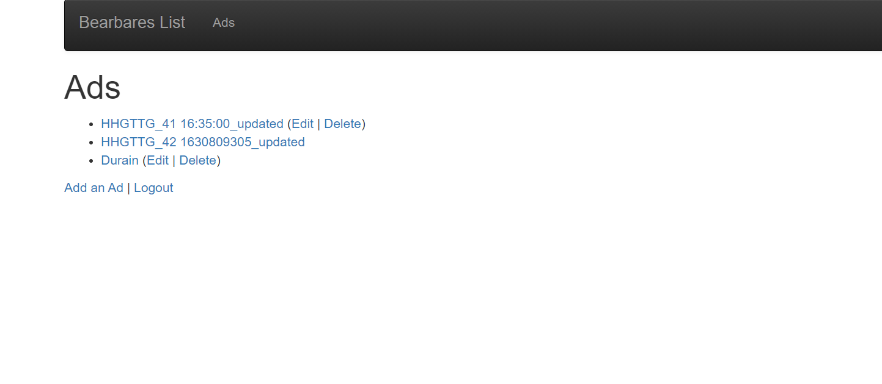
Create ads

